Slide 1
Collaborative Planning

Slide 2
Agenda – November 30, 2021: 5th Grade Sci/SS
Agenda
Review: Teams, Core 4 Values, Norms & Expectations
Ice Breaker: Two Truths and a Lie
Mastery Connect Benchmark & Formative Assessments
Mastery Connect Reports
Mastery Connect Resources
Sharing and Collaborating

Slide 3
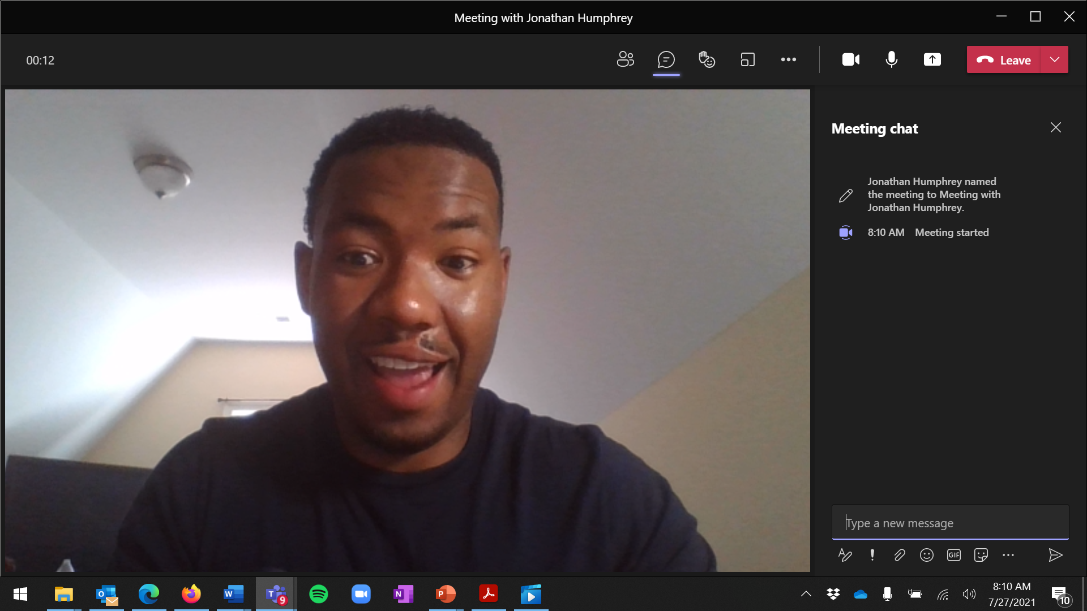
Using TEAMS: Reminders
Raise Hand
Chat feature
Breakout Room
Mute control
Chat conversation will show here
Ensure the volume is turned up on your computer.
Mute your volume when not speaking (to minimize background noise).
Use chat and unmute to comment and ask questions.
Volume control

Slide 4
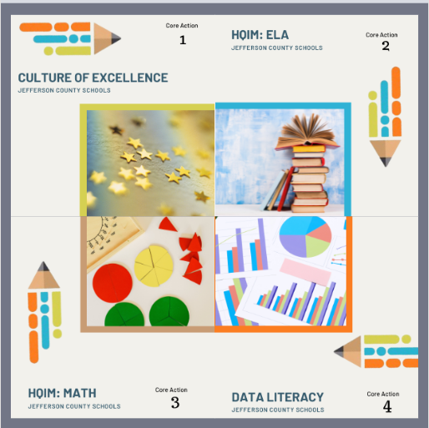
Collaborative Planning - Expectations
CORE 4 Values
Culture of Excellence
2. High Quality Instruction and
Instructional Materials for ELA
3. High Quality Instruction and
Instructional Materials for Math
4. Data Literacy

Slide 5
Collaborative Planning - Expectations
Presence
Be on time.
Be engaged.
Limit distractions.
Limit screen time (phones and devices).
If an urgent matter comes up, step out of the meeting.
Focus
Keep students at the center of focus and decision-making.
Share your voice—ask/answer questions, discuss, share ideas, provide support for one another.
- Please keep your camera on!

Slide 6
Two truths and a lie
Share three separate comments in the chat. Two truths and one false statement.
Respond to each comment made by another person with give it a thumbs up if you think it is true and another appropriate emoji if it is the lie.
We will take turns quickly sharing our truths and lies once everyone has replied to all comments.

Slide 7
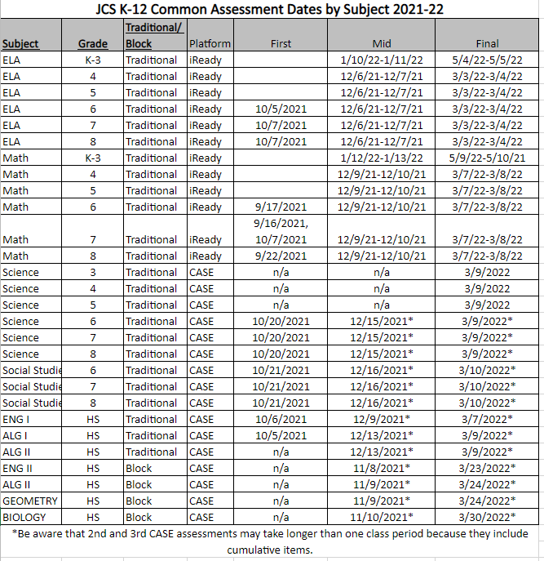
Mastery Connect: Benchmark Assessments
Notes:
Mastery Connect will be used to provide District Benchmark Assessments in March for 5th Grade

Slide 8
Mastery Connect: Formative Assessments
This Photo by Unknown Author is licensed under CC BY-SA
Notes:
But WHY the Formative Assessment
Beginning with the end in mind: What good will the Mastery Connect Formative Assessments be?
This is a tool that is at your disposal. To the best of my knowledge there are no usage mandates, but we do want you to be exposed to the resource so that you can make an informed decision about the value of integrating it in your classroom.
Correction: Science Classes in Grades 3-5 will be required to participate in a District Common Assessment using CASE and Mastery Connect. Mastery Trackers will need to be built ahead of time for this purpose.

Slide 9
Mastery Connect: Question Banks
Notes:
Vetted, quality questions available by standard (CASE and )

Slide 10
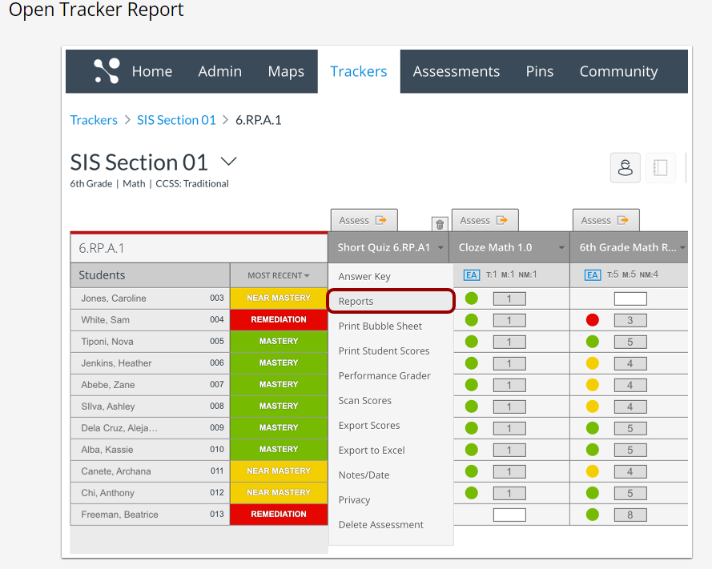
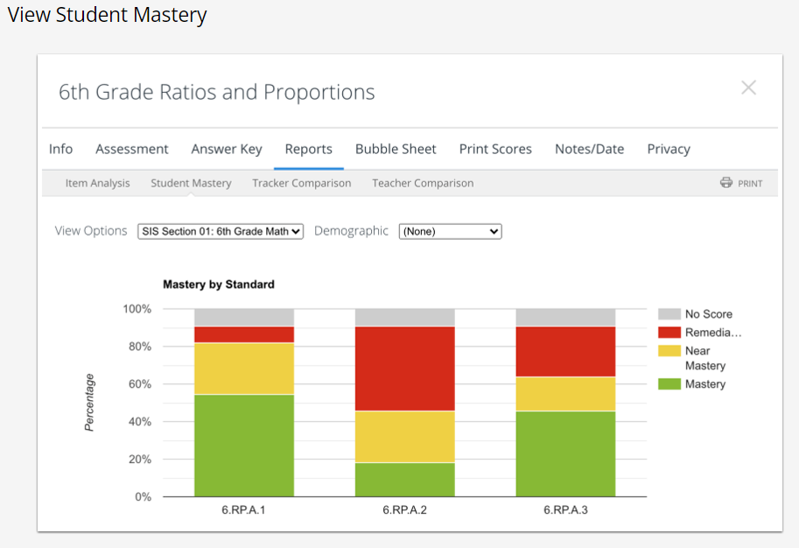
Mastery Connect: Progress Reports
Notes:
Check student progress by standard.
Because it is helpful to have student data in the platform to really evaluate how it works, we have limited experience with this component. However, these are just a couple of reports options available.

Slide 11
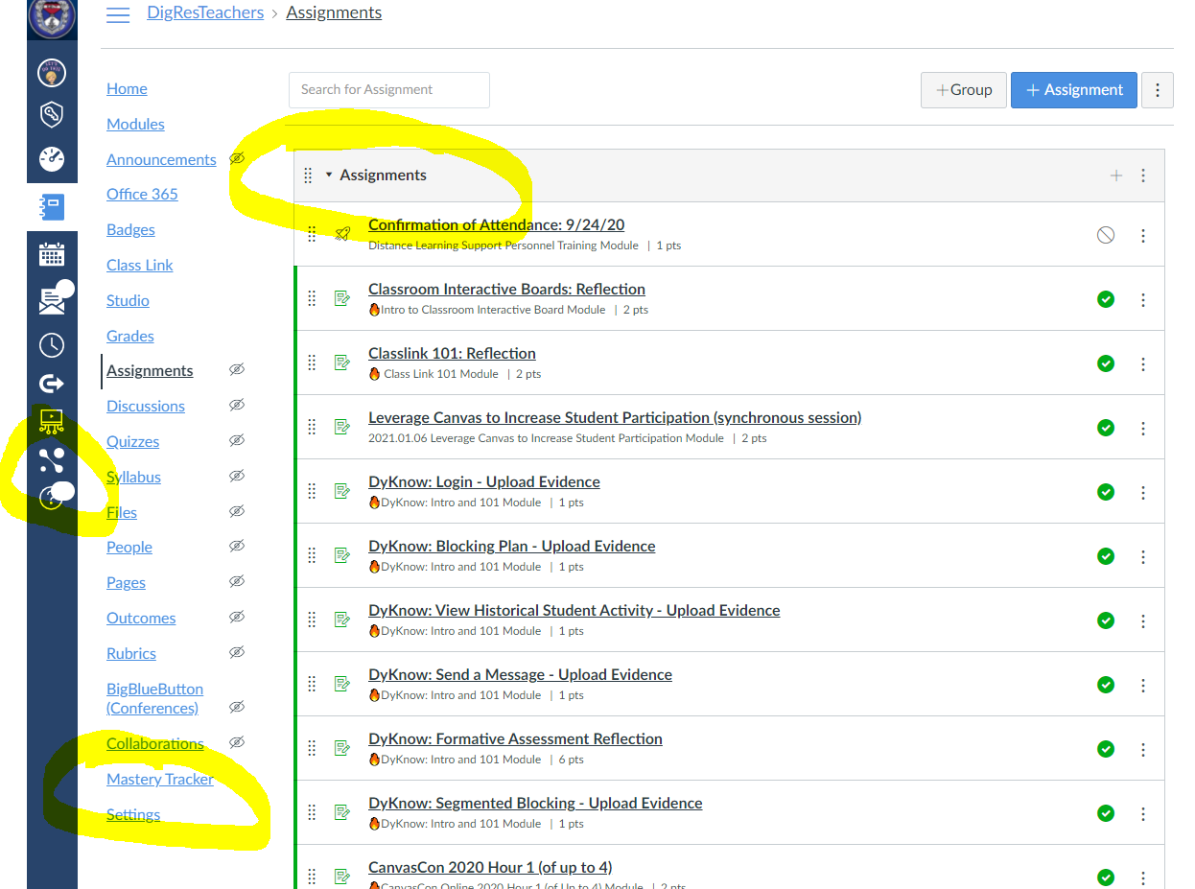
Mastery Connect: Access Through Canvas
Notes:
You and your students can access Mastery Connect through Canvas in the Universal and Course Navigation.
I recommend having students use Assignments Links instead.

Slide 12
Canvas Housekeeping
Hide ALL unnecessary Course Navigation options.
Publish your Course
Consider using Assignments as your Course Front Page
Reintroduce students to Canvas if necessary
Notes:
Before you begin creating assessments for students, do a little Canvas refresher for yourself and your students.
Take a moment to hide Navigation options. Share screen and demonstrate.

Slide 13
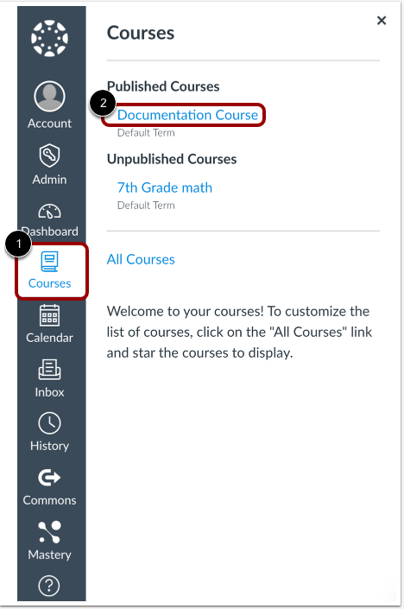
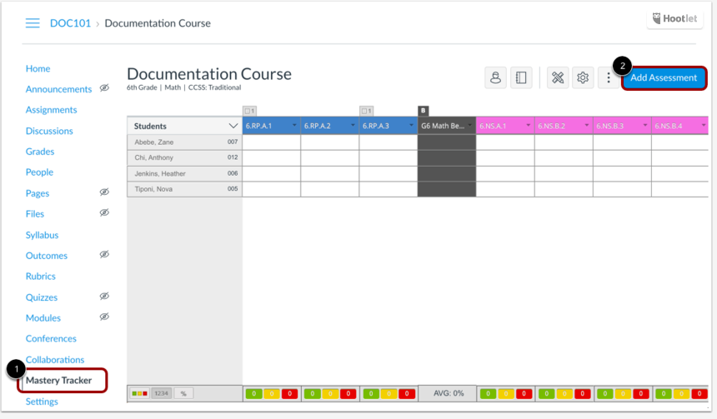
Mastery Connect: Creating Assessments
2
4
1
3
Notes:
There are several ways to create an assessment. The easiest way is to build it as an assignment in Canvas.
You will have options to create or select assessments in the dropdown.

Slide 14
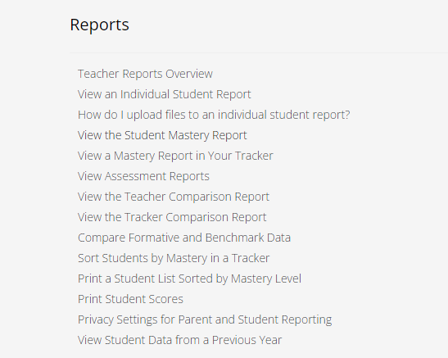
Mastery Connect: Reports
Learn more…
Notes:
Again, there is no way that we have time to dive into all the reporting options, but we will continue to add information and resources to the Digital Resources for Teachers course in Canvas.
If you are not already enrolled in Digital Resources for Teachers Canvas Course, please do.
Take a moment to walk through enrolling in DigRes for Teachers.

Slide 15
Sharing and Collaborating
Please share some thoughts about how you have (or might) use Mastery Connect in your classroom.
What other Formative Assessments are currently working well?

Slide 16
Questions or Support
www.jc-tn.net/techy
Notes:
If you have questions, feel free to share them any time, or request a classroom or PLC visit. The best way to connect is www.jc-tn.net/techy. You can also send an email or give me a call. :)

